Slide 1
Chapter 2 Introduction to HTML5
簡廷因 Ting-Ying Chien
2021.09.23

Slide 2
Outline
Introduction
Editing HTML5
W3C HTML5 Validation Service
First HTML5 Example
Heading
Linking

Slide 3
Outline
Images
alt Attribute
Void Element
Using Images as Hyperlinks
Special Characters and Horizontal Rules
Lists
Tables
Form
Internal linking
meta

Slide 4
Introduction
HTML5 (HyperText Markup Language 5)
HTML5 is a markup language that specifies the structure and content of documents that are displayed in web browsers

Slide 5
Editing HTML5
Text Editor
Free
notepad
notepad++
vim
emacs
eclipse
KompoZer
Google Web Designer
Commercial software
Dreamweaver
Ultraedit

Slide 6
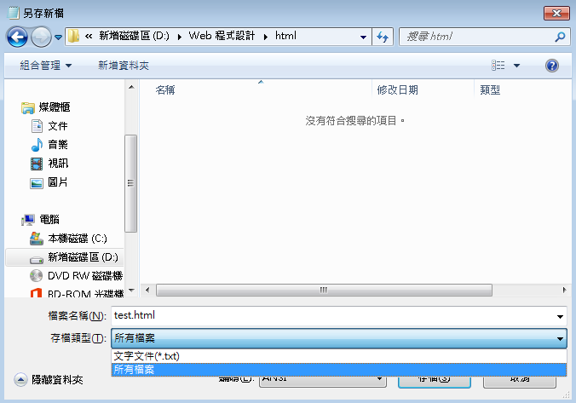
Editing HTML5
Saving it with the .html or .htm filename extension
“存檔類型”要改成”所有檔案”

Slide 7
W3C HTML5 Validation Service
http://validator.w3.org/
URL
File upload
Direct Input

Slide 8
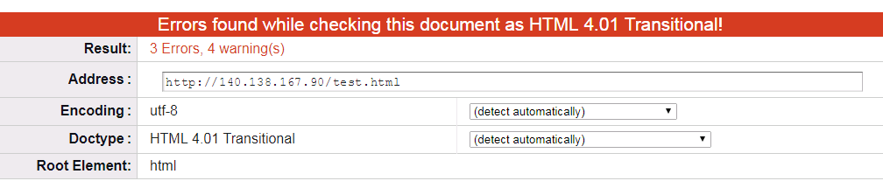
W3C HTML5 Validation Service
Test
http://YOURIP:PORT/test.html

Slide 9
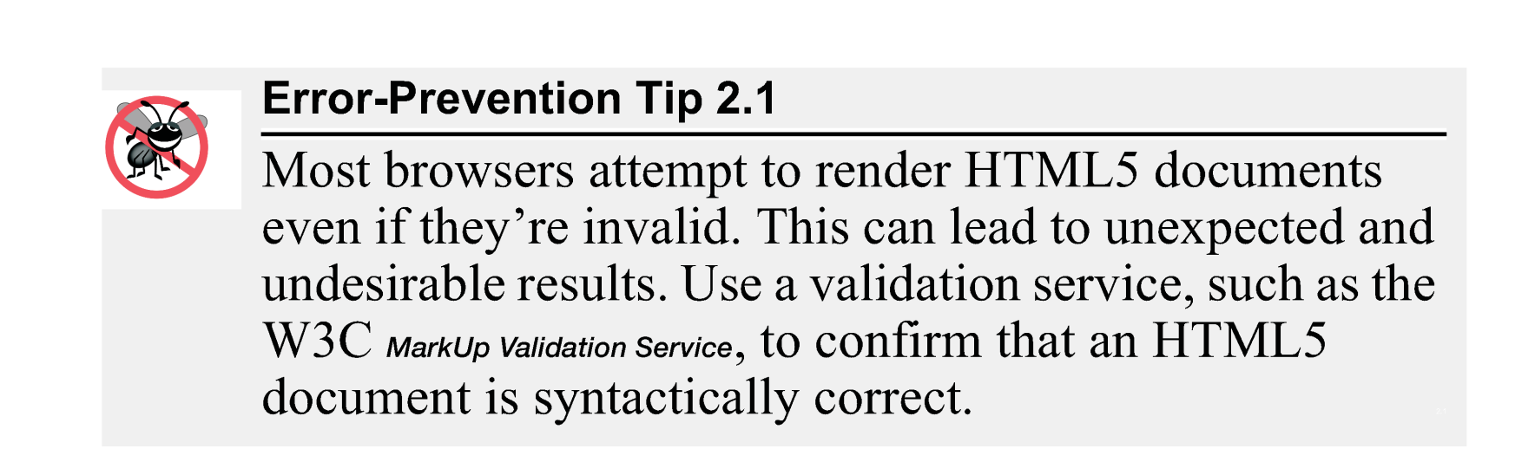
W3C HTML5 Validation Service
HTML5 documents that contain syntax errors may not display properly

Slide 10
Another example
Example: main.html
<!DOCTYPE html>
<!-- Fig. 2.1: main.html -->
<!-- First HTML5 example. -->
<html>
<head>
<meta charset = "utf-8">
<title>Welcome</title>
</head>
<body>
<p>Welcome to HTML5!</p>
</body>
</html>

Slide 11
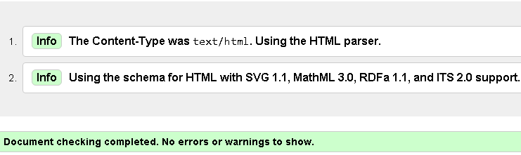
Another example
Example: main.html
Example: test.html

Slide 12
Another example
Example: main.html
Example: test.html
<!DOCTYPE html>
<!-- Fig. 2.1: main.html -->
<!-- First HTML5 example. -->
<html>
<head>
<meta charset = "utf-8">
<title>Welcome</title>
</head>
<body>
<p>Welcome to HTML5!</p>
</body>
</html>
<html>
<head>
<meta charset = "utf-8">
<title> Hello World </title>
</head>
<body>
<p> Hello World!! </p>
</body>
</html>

Slide 13
DOCTYPE
Document Type Declaration
The document type declaration (DOCTYPE) is required in HTML5 documents so that browsers render the page in standards mode.
HTML 5
HTML4
Others
http://www.w3schools.com/tags/tag_doctype.asp
<!DOCTYPE html>
<!DOCTYPE HTML PUBLIC "-W3CDTD HTML 4.01 Transitional//EN"
"http://www.w3.org/TR/html4/loose.dtd">

Slide 14
Comments
Insert comments in your HTML5 markup to improve readability and describe the content of a document.
The browser ignores comments when your document is rendered.
Comments start with <!-- and end with -->.
<!DOCTYPE html>
<!-- Fig. 2.1: main.html -->
<!-- First HTML5 example. -->
<html>
<head>
<meta charset = "utf-8">
<title>Welcome</title>
</head>
<body>
<p>Welcome to HTML5!</p>
</body>
</html>

Slide 15
html, head and body Elements
The html element encloses the head section (represented by the head element) and the body section (represented by the body element).
<!DOCTYPE html>
<!-- Fig. 2.1: main.html -->
<!-- First HTML5 example. -->
<html>
<head>
<meta charset = "utf-8">
<title>Welcome</title>
</head>
<body>
<p>Welcome to HTML5!</p>
</body>
</html>

Slide 16
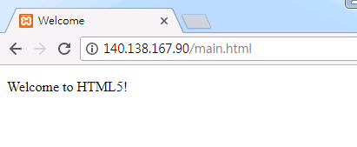
html, head and body Elements
The head section contains information about the HTML5 document, such as the character set (UTF-8, the most popular character-encoding scheme for the web) that the page use – which helps the browser determine how to render the content- and the title.
<!DOCTYPE html>
<!-- Fig. 2.1: main.html -->
<!-- First HTML5 example. -->
<html>
<head>
<meta charset = "utf-8">
<title>Welcome</title>
</head>
<body>
<p>Welcome to HTML5!</p>
</body>
</html>

Slide 17
html, head and body Elements
Title Element
The title element is called a nested element, because it’s enclosed in the head element’s start and end tags.
The head element is also a nested element, because it’s enclosed in the html element’s start and end tags.
The title element describes the web page.

Slide 18
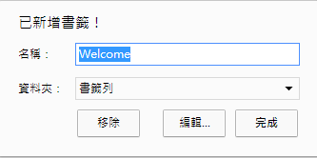
html, head and body Elements
Title Element
Titles usually appear in the title bar at the top of the browser window, in the browser tab on which the page is displayed, and also as the text identifying a page when users add the page to their list of Favorites or Bookmarks, enabling them to return to their favorite sites.
Search engines use the title for indexing purposes and when displaying results

Slide 19
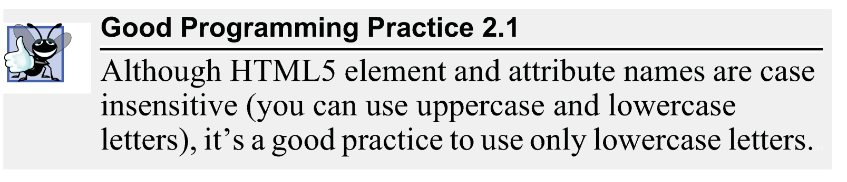

html, head and body Elements

Slide 20
html, head and body Elements
The head section also can contain special document-formatting instructions called CSS3 style sheets and client-side programs called scripts for creating dynamic web pages.
<head>
<meta charset = "utf-8">
<title>Welcome</title>
<link rel="stylesheet" type="text/css" media="all" href="test.css" />
<script type="text/javascript" src="test.js"></script>
</head>

Slide 21
html, head and body Elements
The body section contains the page’s content, which the browser displays when the user visits the web page.
<!DOCTYPE html>
<!-- Fig. 2.1: main.html -->
<!-- First HTML5 example. -->
<html>
<head>
<meta charset = "utf-8">
<title>Welcome</title>
</head>
<body>
<p>Welcome to HTML5!</p>
</body>
</html>

Slide 22
Start Tags and End Tags
HTML5 documents delimit most elements with a start tag and end tag.
A start tag consists of the element name in angle brackets
For example, <html>
An end tag consists of the element name preceded by a forward slash (/) in angle brackets
For example, </html>

Slide 23
Start Tags and End Tags
There are several so-called “void elements” that do not have end tags.
Many start tags have attributes that provide additional information about an element, which browsers use to determine how to process the element.
Each attribute has a name and a value separated by an equals sign (=).
<img src = "buttons/links.jpg" width = "65" height = "50" alt = "Links">

Slide 24
Paragraph Element
Paragraph Element (<p>...</p>)
All text placed between the <p> and </p> tags forms one paragraph.
<!DOCTYPE html>
<!-- Fig. 2.1: main.html -->
<!-- First HTML5 example. -->
<html>
<head>
<meta charset = "utf-8">
<title>Welcome</title>
</head>
<body>
<p>Welcome to HTML5!</p>
</body>
</html>

Slide 25
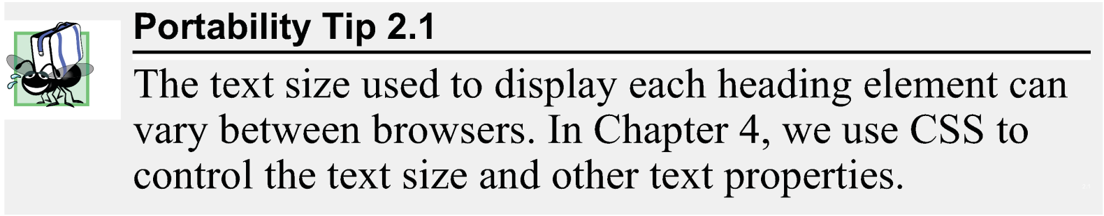
Headings
HTML5 provides six heading elements (h1 through h6) for specifying the relative importance of information
Heading element h1 is considered the most significant heading and is rendered in the largest font.
Each successive heading element (i.e., h2, h3, etc.) is rendered in a progressively smaller font.

Slide 26
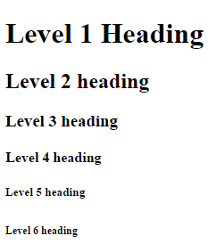
Headings
<!DOCTYPE html>
<!-- Fig. 2.2: heading.html -->
<!-- Heading elements h1 through h6. -->
<html>
<head>
<meta charset = "utf-8">
<title>Headings</title>
</head>
<body>
<h1>Level 1 Heading</h1>
<h2>Level 2 heading</h2>
<h3>Level 3 heading</h3>
<h4>Level 4 heading</h4>
<h5>Level 5 heading</h5>
<h6>Level 6 heading</h6>
</body>
</html>

Slide 27
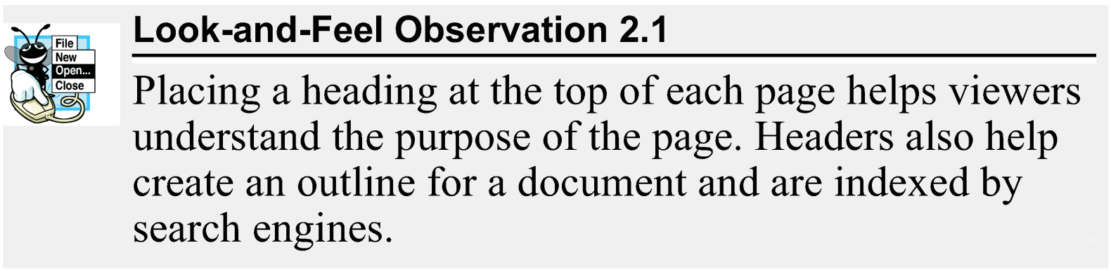
Headings

Slide 28
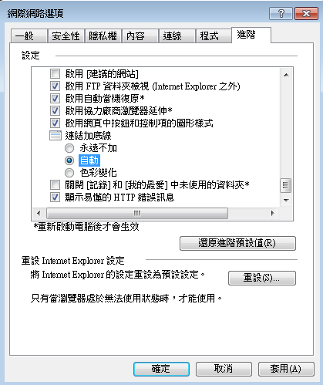
Linking
A hyperlink references or links to other resources, such as HTML5 documents and images.
Web browsers typically underline text hyperlinks and color them blue by default.

Slide 29
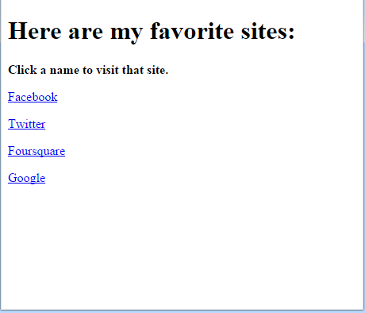
Linking
<!DOCTYPE html>
<!-- Fig. 2.3: links.html -->
<!-- Linking to other web pages. -->
<html>
<head>
<meta charset = "utf-8">
<title>Links</title>
</head>
<body>
<h1>Here are my favorite sites:</h1>
<p><strong>Click a name to visit that site.</strong></p>
<!-- create four text hyperlinks -->
<p><a href = "http://www.facebook.com">Facebook</a></p>
<p><a href = "http://www.twitter.com">Twitter</a></p>
<p><a href = "http://www.fourquare.com">Foursquare</a></p>
<p><a href = "http://www.google.com">Google</a></p>
</body>
</html>

Slide 30
Linking
strong element
the content has high importance
Browsers typically render such text in a bold font
Note :
<strong> : emphasize
<b> : bold font
a (anchor) element
Attribute href (hypertext reference) specifies a resource’s location, such as
a web page or location within a web page
a file
an e-mail address

Slide 31
Linking
When a URL does not indicate a specific document on the website, the web server returns a default web page. This page is often called index.html, but most web servers can be configured to use any file as the default web page for the site.
Linux
/etc/apache2/mods-enabled/dir.conf
Windows
INSTALL DIR/conf/httpd.conf

Slide 32
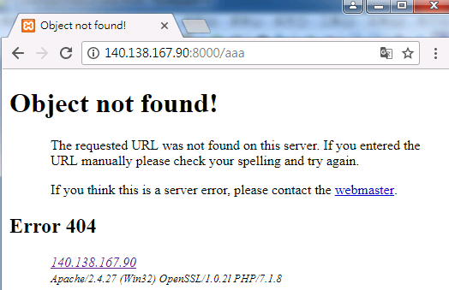
Linking
If the web server cannot locate a requested document, it returns an error indication to the web browser (known as a 404 error), and the browser displays a web page containing an error message.

Slide 33
Linking
Setup 404 Error
Windows (Xampp)
INSTALL DIR/apache/conf/httpd.conf
Add file : INSTALL DIR/htdocs/missing.html
Linux (apache)
/etc/apache2/conf-available/localized-error-pages.conf
Add file : /var/www/html/missing.html
#ErrorDocument 404 /missing.html
ErrorDocument 404 /missing.html
(For XAMPP)
Include conf/extra/httpd-multilang-errordoc.conf
#Include conf/extra/httpd-multilang-errordoc.conf

Slide 34
Linking
Hyperlinking to an E-Mail Address
Anchors can link to an e-mail address using a mailto: URL
Add subject : mailto:EMail?subject=TITLE
When a user clicks this type of anchored link, most browsers launch the default e-mail program (e.g., Mozilla Thunderbird, Microsoft Outlook or Apple Mail) to enable the user to write an e-mail message to the linked address.

Slide 35
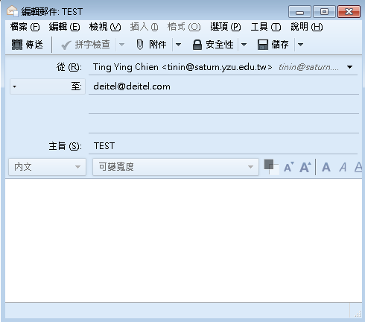

Linking
<!DOCTYPE html>
<!-- Fig. 2.4: contact.html -->
<!-- Linking to an e-mail address. -->
<html>
<head>
<meta charset = "utf-8">
<title>Contact Page</title>
</head>
<body>
<p>
To write to <a href = "mailto:deitel@deitel.com?subject=TEST">
Deitel & Associates, Inc.</a>, click the link and your default
email client will open an email message and address it to us.
</p>
</body>
</html>

Slide 36
Images
The most popular image formats used by web developers today are PNG (Portable Network Graphics) and JPEG (Joint Photographic Experts Group).

Slide 37
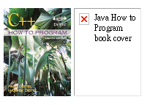

Images
<!DOCTYPE html>
<!-- Fig. 2.6: picture.html -->
<!-- Including images in HTML5 files. -->
<html>
<head>
<meta charset = "utf-8">
<title>Images</title>
</head>
<body>
<p>
<img src = "cpphtp.png" width = "92" height = "120"
alt = "C++ How to Program book cover">
<img src = "jhtp.png" width = "92" height = "120"
alt = "Java How to Program book cover">
</p>
</body>
</html>
cpphtp.png

Slide 38
Images
The img element’s src attribute specifies an image’s location
Every img element must have an alt attribute, which contains text that is displayed if the client cannot render the image
Width and height are optional attributes
If omitted, the browser uses the image’s actual width and height
Images are measured in pixels

Slide 39
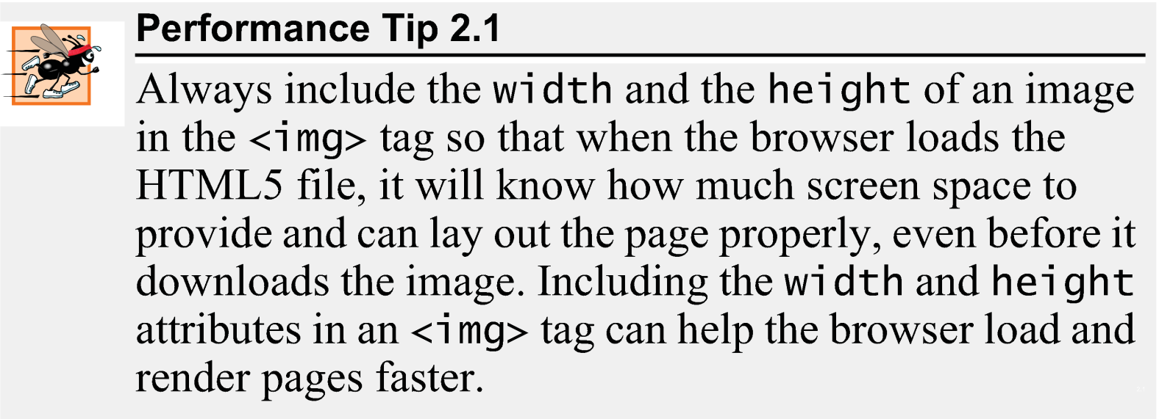
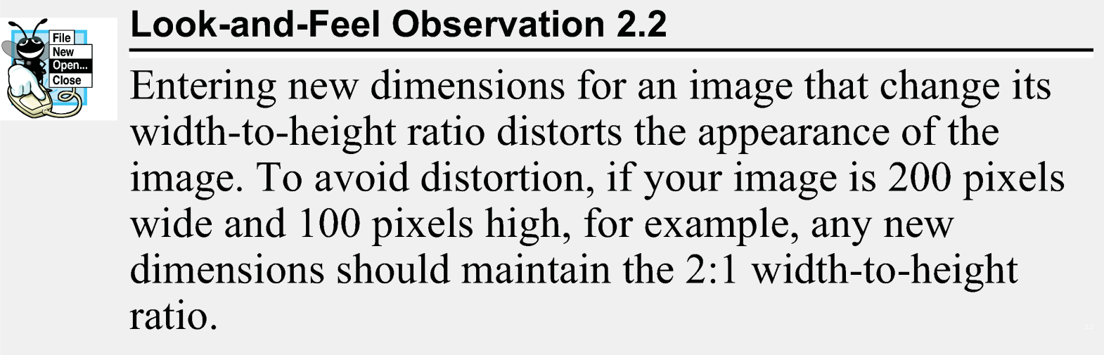
Images

Slide 40
Images
alt Attribute
A browser may not be able to render an image.
Every img element in an HTML5 document must have an alt attribute.
If a browser cannot render an image, the browser displays the alt attribute’s value.
The alt attribute is also important for accessibility—speech synthesizer software can speak the alt attribute’s value so that a visually impaired user can understand what the browser is displaying. For this reason, the alt attribute should describe the image’s contents.

Slide 41
Images
Void Elements
Some HTML5 elements (called void elements) contain only attributes and do not mark up text (i.e., text is not placed between a start and an end tag).
You can terminate void elements (such as the img element) by using the forward slash character (/) inside the closing right angle bracket (>) of the start tag.
<img src = "jhtp.png" width = "92" height = "120"
alt = "Java How to Program book cover" />

Slide 42
Images
Using Images as Hyperlinks
By using images as hyperlinks, you can create graphical web pages that link to other resources

Slide 43






Images
links.jpg
list.jpg
contact.jpg
table.jpg
form.jpg
<!DOCTYPE html>
<!-- Fig. 2.7: nav.html -->
<!-- Images as link anchors. -->
<html>
<head>
<meta charset = "utf-8">
<title>Navigation Bar</title>
</head>
<body>
<p>
<a href = "links.html">
<img src = "links.jpg" width = "65" height = "50" alt = "Links">
</a>
<a href = "list.html">
<img src = "list.jpg" width = "65" height = "50" alt = "List of Features">
</a>
<a href = "contact.html">
<img src = "contact.jpg" width = "65" height = "50" alt = "Contact Me">
</a>
<a href = "table1.html">
<img src = "table.jpg" width = "65" height = "50" alt = "Tables Page">
</a>
<a href = "form.html">
<img src = "form.jpg" width = "65" height = "50" alt = "Feedback Form">
</a>
</p>
</body>
</html>

Slide 44
Special Characters and Horizontal Rules
HTML5 provides character entity references (in the form &code;) for representing special characters that cannot be rendered otherwise
The code can be:
Word abbreviations
Numbers
Decimal
Hexadecimal

Slide 45
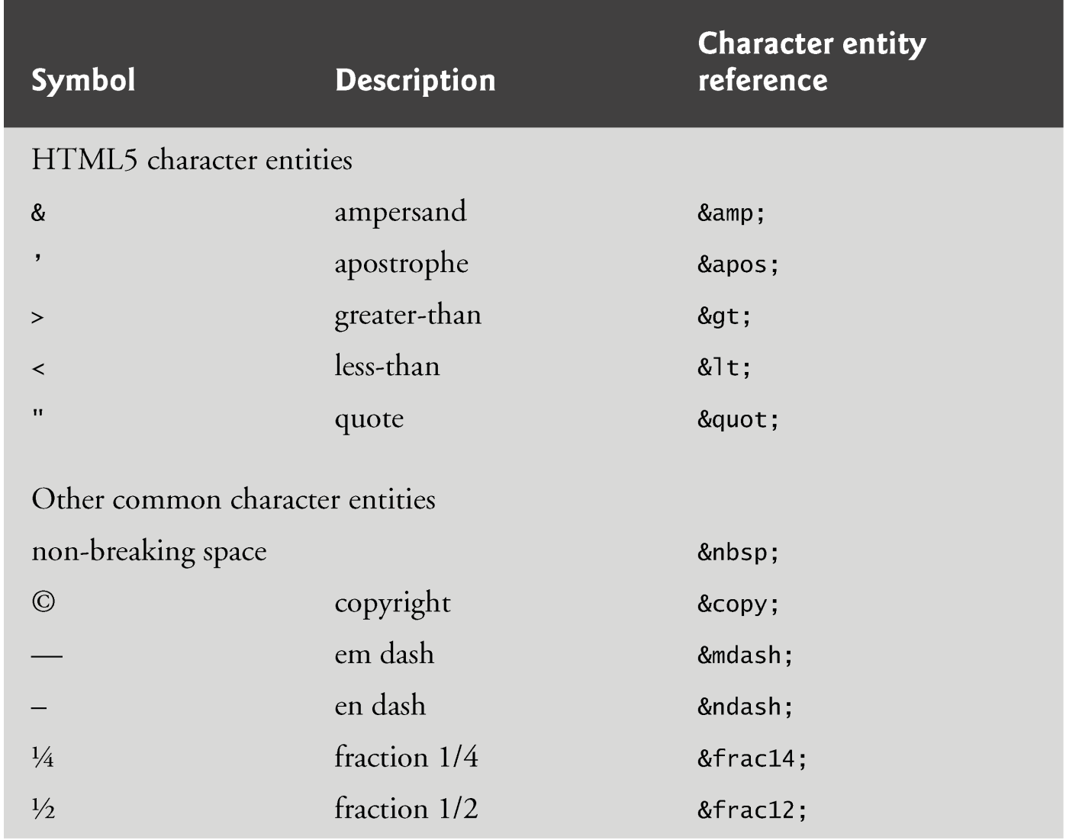
Special Characters and Horizontal Rules

Slide 46
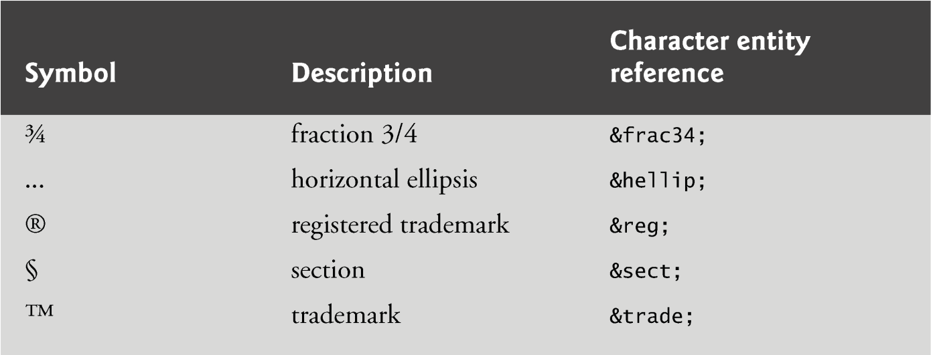
Special Characters and Horizontal Rules
Ref:
http://www.w3.org/TR/REC-html40/sgml/entities.html

Slide 47
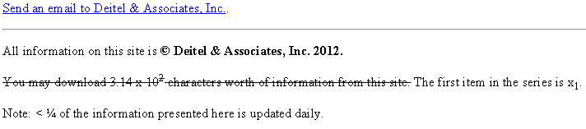
Special Characters and Horizontal Rules
<!DOCTYPE html>
<html>
<head>
<meta charset = "utf-8">
<title>Contact Page</title>
</head>
<body>
<p>
<a href = "mailto:deitel@deitel.com">Send an email to
Deitel &amp; Associates, Inc.</a>.
</p>
<hr>
<p>All information on this site is <strong>&copy;
Deitel & Associates, Inc. 2012.</strong> </p>
<p><del>You may download 3.14 x 10<sup>2</sup>
characters worth of information from this site.</del>
The first item in the series is x<sub>1</sub>.</p>
<p>Note: &lt; &frac14; of the information
presented here is updated daily.</p>
</body>
</html>
<hr> 水平線
<del> 刪除線
<sup> 上標
<sub> 下標

Slide 48
Special Characters and Horizontal Rules
A horizontal rule, indicated by the <hr> tag renders a horizontal line with extra space above and below it in most browsers.
The horizontal rule element should be considered a legacy element and you should avoid using it.
CSS can be used to add horizontal rules and other formatting to documents.

Slide 49
Lists
Unordered list element ul
creates a list in which each item in the list begins with a bullet symbol (typically a disc)
Each entry is an li (list item) element. Most web browsers render these elements with a line break and a bullet symbol at the beginning of the line.

Slide 50
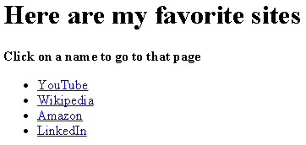
Lists
<!DOCTYPE html>
<!-- Fig. 2.10: links2.html -->
<!-- Unordered list containing hyperlinks. -->
<html>
<head>
<meta charset = "utf-8">
<title>Links</title>
</head>
<body>
<h1>Here are my favorite sites</h1>
<p><strong>Click on a name to go to that page</strong></p>
<!-- create an unordered list -->
<ul>
<!-- the list contains four list items -->
<li><a href = "http://www.youtube.com">YouTube</a></li>
<li><a href = "http://www.wikipedia.org">Wikipedia</a></li>
<li><a href = "http://www.amazon.com">Amazon</a></li>
<li><a href = "http://www.linkedin.com">LinkedIn</a></li>
</ul>
</body>
</html>

Slide 51
Lists
Nested Lists
Lists may be nested to represent hierarchical relationships, as in a multi-level outline.
The ordered-list element ol creates a list in which each item begins with a number.

Slide 52
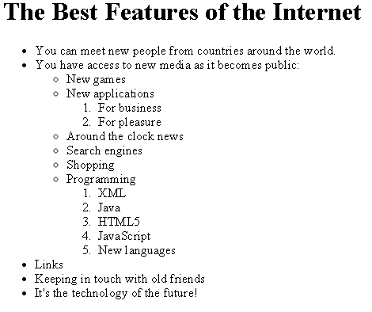
Lists
<!DOCTYPE html>
<html>
<head>
<meta charset = "utf-8">
<title>Lists</title>
</head>
<body>
<h1>The Best Features of the Internet</h1>
<ul>
<li>You can meet new people from countries around
the world.</li>
<li>
You have access to new media as it becomes public:
<ul>
<li>New games</li>
<li>New applications
<ol>
<li>For business</li>
<li>For pleasure</li>
</ol>
</li>
<li>Around the clock news</li>
<li>Search engines</li>
<li>Shopping</li>
<li>Programming
<ol>
<li>XML</li>
<li>Java</li>
<li>HTML5</li>
<li>JavaScript</li>
<li>New languages</li>
</ol>
</li>
</ul>
</li>
<li>Links</li>
<li>Keeping in touch with old friends</li>
<li>It's the technology of the future!</li>
</ul>
</body>
</html>

Slide 53
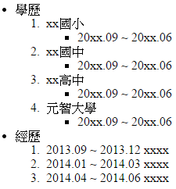
Exercises
https://validator.w3.org/

Slide 54
Tables
Tables are frequently used to organize data into rows and columns.
The table element defines an HTML5 table
The summary attribute summarizes the table’s contents and is used by speech devices to make the table more accessible to users with visual impairments.
The caption element specifies a table’s title.

Slide 55
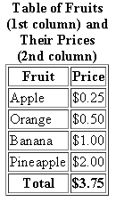
<!DOCTYPE html>
<html>
<head>
<meta charset = "utf-8">
<title>A simple HTML5 table</title>
</head>
<body>
<table border = "1">
<caption><strong>Table of Fruits (1st column) and Their Prices (2nd column)</strong></caption>
<thead>
<tr>
<th>Fruit</th>
<th>Price</th>
</tr>
</thead>
<tfoot>
<tr>
<th>Total</th>
<th>$3.75</th>
</tr>
</tfoot>
<tbody>
<tr>
<td>Apple</td>
<td>$0.25</td>
</tr>
<tr>
<td>Orange</td>
<td>$0.50</td>
</tr>
<tr>
<td>Banana</td>
<td>$1.00</td>
</tr>
<tr>
<td>Pineapple</td>
<td>$2.00</td>
</tr>
</tbody>
</table>
</body>
</html>

Slide 56
Tables
A table can be split into three distinct sections:
Head (thead element)
Table titles
Column headers
Body (tbody element)
Primary table data
Table Foot (tfoot element)
Calculation results
Footnotes
Above body section in the code, but displays at the bottom in the page

Slide 57
Tables
tr Element
Defines individual table rows
th Element
Defines a header cell
Most Web browsers change the font weight to bold and center the content in a <th> cell.
td Element
Contains table data elements

Slide 58
Tables
Using rowspan and colspan with Tables
You can merge data cells with the rowspan and colspan attributes
The values of these attributes specify the number of rows or columns occupied by the cell.
Can be placed inside any data cell or table header cell.
The br element is render as a line break in most browsers - any markup or text following a br element is rendered on the next line.
Like the img element, br is an example of a void element.
Like the hr element, br is considered a legacy formatting element that you should avoid using
in general, formatting should be specified using CSS.

Slide 59
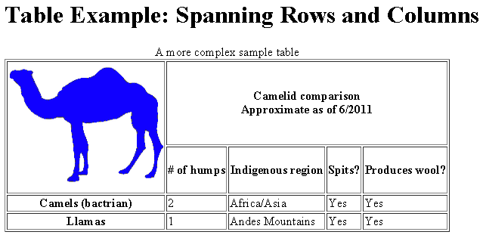
Tables
<!DOCTYPE html>
<html>
<head>
<meta charset = "utf-8">
<title>Tables</title>
</head>
<body>
<h1>Table Example: Spanning Rows and Columns</h1>
<table border = "1">
<caption>A more complex sample table</caption>
<thead>
<tr>
<th rowspan = "2">
<img src = "camel.png" width = "205"
height = "167" alt = "Picture of a one-hump camel">
</th>
<th colspan = "4">
<strong>Camelid comparison</strong><br>
Approximate as of 6/2011
</th>
</tr>
<tr>
<th># of humps</th>
<th>Indigenous region</th>
<th>Spits?</th>
<th>Produces wool?</th>
</tr>
</thead>
<tbody>
<tr>
<th>Camels (bactrian)</th>
<td>2</td>
<td>Africa/Asia</td>
<td>Yes</td>
<td>Yes</td>
</tr>
<tr>
<th>Llamas</th>
<td>1</td>
<td>Andes Mountains</td>
<td>Yes</td>
<td>Yes</td>
</tr>
</tbody>
</table>
</body>
</html>
4
2

Slide 60
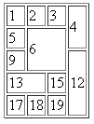
Tables
<!DOCTYPE html>
<html>
<head>
<meta charset = "utf-8">
<title>Table</title>
</head>
<body>
<table border = "1">
<tr>
<td>1</td>
<td>2</td>
<td>3</td>
<td rowspan="2">4</td>
</tr>
<tr>
<td>5</td>
<td rowspan="2" colspan="2">6</td>
</tr>
<tr>
<td>9</td>
<td rowspan="3">12</td>
</tr>
<tr>
<td colspan="2">13</td>
<td>15</td>
</tr>
<tr>
<td>17</td>
<td>18</td>
<td>19</td>
</tr>
</table>
</body>
</html>
Merge
4, 8
6, 7, 10, 11
12 , 16, 20
13, 14
Step 2:
紀錄合併的格子編號(按順序)
Step 4:
從1開始編格子
Step 5:
碰到合併的就設定
rowspan跟colspan
Step 1:
將表格從左至右、上至下編號
1 | 2 | 3 | 4
5 | 6 | 7 | 8
9 | 10 | 11 | 12
13 | 14 | 15 | 16
17 | 18 | 19 | 20
Step 3:
合併的格子保留最小編號
1 | 2 | 3 | 4
5 | 6
9 |  |  | 12
13 |  | 15
17 | 18 | 19

Slide 61
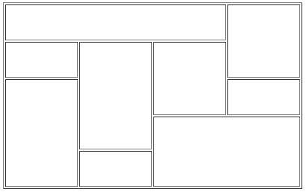
Exercises
Hint :
<table border = "1" width=400 height= 250>

Slide 62
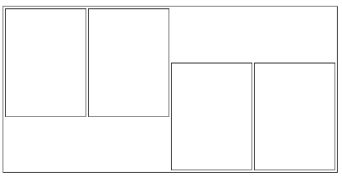
Table rowspan
3
2
<!DOCTYPE html>
<html>
<head>
<meta charset = "utf-8">
<title>Table</title>
</head>
<body>
<table border = "1" width=400 height= 200>
<tr>
<td rowspan = "2" colspan = "3" ></td>
<td rowspan = "2" colspan = "2" ></td>
</tr>
<tr>
<td rowspan = "2" colspan = "2" ></td>
<td rowspan = "2" colspan = "3" ></td>
</tr>
</table>
</body>
</html>
2
2
2
3
ERROR!! WHY?

Slide 63

Table rowspan
How to fix ?
3
2
<!DOCTYPE html>
<html>
<head>
<meta charset = "utf-8">
<title>Table</title>
</head>
<body>
<table border = "1" width=400 height= 200>
<tr>
<td rowspan = "2" colspan = "3" ></td>
<td rowspan = "2" colspan = "2" ></td>
</tr>
<tr></tr>
<tr>
<td rowspan = "2" colspan = "2" ></td>
<td rowspan = "2" colspan = "3" ></td>
</tr>
<tr></tr>
</table>
</body>
</html>
2
2
2
3

Slide 64
Tables
Step 2:
紀錄合併的格子編號(按順序)
Merge
1,2,3,6,7, 8
4, 5, 9,10
11,12,16,17
13, 14,15,18,19,20
Step 4:
從1開始編格子
<!DOCTYPE html>
<html>
<head>
<meta charset = "utf-8">
<title>Table</title>
</head>
<body>
<table border = "1" width=400 height= 200>
<tr>
<td rowspan = "2" colspan = "3" ></td>
<td rowspan = "2" colspan = "2" ></td>
</tr>
<tr></tr>
<tr>
<td rowspan = "2" colspan = "2" ></td>
<td rowspan = "2" colspan = "3" ></td>
</tr>
<tr></tr>
</table>
</body>
</html>
Step 5:
碰到合併的就設定
rowspan跟colspan
Step 1:
將表格從左至右、上至下編號
1 | 2 | 3 | 4 | 5
6 | 7 | 8 | 9 | 10
11 | 12 | 13 | 14 | 15
16 | 17 | 18 | 19 | 20
Step 3:
合併的格子保留最小編號
1 |  | 4
11 | 13

Slide 65
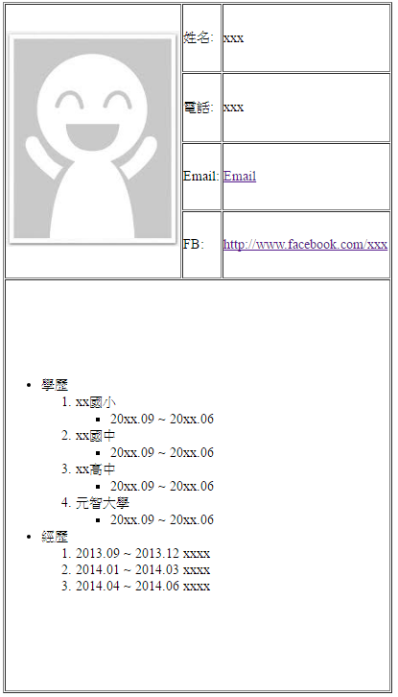
Exercise
400 px
40%
Curriculum Vitae
40%
10%
800 px

Slide 66
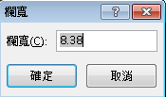
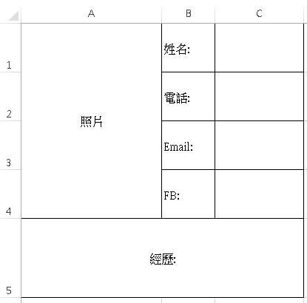

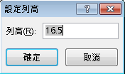
Exercise
Curriculum Vitae
Hint:
width
rowspan
height
colspan

Slide 67
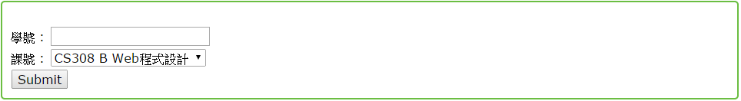
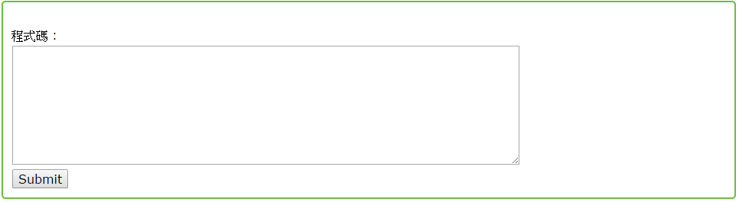
Form
HTML5 provides forms for collecting information from users.

Slide 68
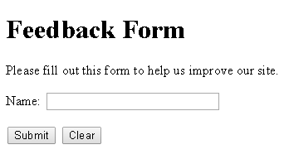
Form
<!DOCTYPE html>
<html>
<head>
<meta charset = "utf-8">
<title>Forms</title>
</head>
<body>
<h1>Feedback Form</h1>
<p>Please fill out this form to help us improve our site.</p>
<form method = "post" action = "http://www.deitel.com">
<input type = "hidden" name = "recipient" value = "deitel@deitel.com">
<input type = "hidden" name = "subject" value = "Feedback Form">
<input type = "hidden" name = "redirect" value = "main.html">
<p><label>Name:
<input name = "name" type = "text" size = "25"
maxlength = "30">
</label></p>
<p>
<input type = "submit" value = "Submit">
<input type = "reset" value = "Clear">
</p>
</form>
</body>
</html>
傳值方式及接收位置
純粹傳值, 網頁上不顯示
送出表格
清除表格

Slide 69
Form
A form is defined by a form element
Attribute method specifies how the form’s data is sent to the web server.
Using method = "post" appends form data to the browser request, which contains the protocol (HTTP) and the requested resource’s URL.
The other possible value, method = "get", appends the form data directly to the end of the URL of the script, where it’s visible in the browser’s Address field.
The action attribute of the form element specifies the script to which the form data will be sent

Slide 70
Form
Ref:
http://www.wibibi.com/info.php?tid=235
 | GET | POST
網址差異 | 網址會帶有 HTML Form 表單的參數與資料。 | 資料傳遞時，網址並不會改變。
資料傳遞量 | 由於是透過 URL 帶資料，所以有長度限制。 | 由於不透過 URL 帶參數，所以不受限於 URL 長度限制。
安全性 | 表單參數與填寫內容可在 URL 看到。 | 透過 HTTP Request 方式，故參數與填寫內容不會顯示於 URL。

Slide 71
Form
input elements that specify data to provide to the script that processes the form (also called the form handler).
An input’s type is determined by its type attribute.
<input type = "hidden" name = "recipient" value = "deitel@deitel.com">
<input type = "text" name = "name" size = “25" maxlength = "30">
<input type = "submit" value = "Submit">
<input type = "reset" value = "Clear">

Slide 72
Form
Hidden Inputs
Forms can contain visual and nonvisual components.
Visual components include clickable buttons and other graphical user interface components with which users interact.
Nonvisual components, called hidden inputs, store any data that you specify, such as e-mail addresses and HTML5 document file names that act as links.

Slide 73
Form
The text input inserts a text field into the form, which allows the user to input data.
The label element provides users with information about the input element’s purpose
The size attribute specifies the number of characters visible in the text field.
Optional attribute maxlength limits the number of characters input into a text field.
<label>Name:
<input name = “name” type = “text” size = “25” maxlength = "30">
</label>

Slide 74
Form
The submit input element is a button.
When the submit button is pressed, the form’s data is sent to the location specified in the form’s action attribute.
The value attribute sets the text displayed on the button.
The reset input element allows a user to reset all form elements to their default values.
<input type = "submit" value = "Submit">
<input type = "reset" value = "Clear">

Slide 75
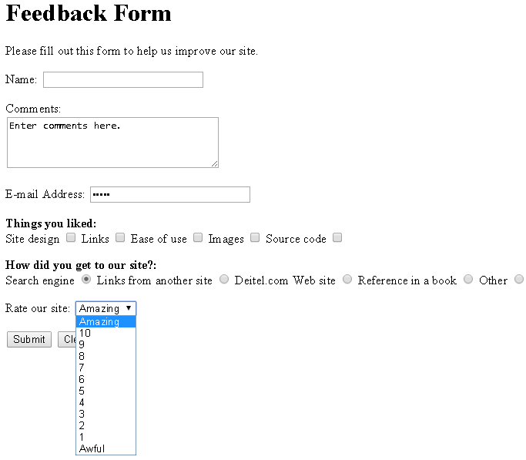
Form
<!DOCTYPE html>
<html>
<head>
<meta charset = "utf-8">
<title>More Forms</title>
</head>
<body>
<h1>Feedback Form</h1>
<p>Please fill out this form to help us improve our site.</p>
<form method = "post" action = "http://www.deitel.com">
<input type = "hidden" name = "recipient" value = "deitel@deitel.com">
<input type = "hidden" name = "subject" value = "Feedback Form">
<input type = "hidden" name = "redirect" value = "main.html">
<p><label>Name:
<input name = "name" type = "text" size = "25">
</label></p>
<p><label>Comments:<br>
<textarea name = "comments" rows = "4" cols = "36">Enter comments here.</textarea>
</label></p>
<p><label>E-mail Address:
<input name = "email" type = "password" size = "25">
</label></p>
總共幾列, 一列幾個字
輸入的字變•

Slide 76
Form
<p>
<strong>Things you liked:</strong><br>
<label>Site design
<input name = "thingsliked" type = "checkbox" value = "Design"></label>
<label>Links
<input name = "thingsliked" type = "checkbox" value = "Links"></label>
<label>Ease of use
<input name = "thingsliked" type = "checkbox" value = "Ease"></label>
<label>Images
<input name = "thingsliked" type = "checkbox" value = "Images"></label>
<label>Source code
<input name = "thingsliked" type = "checkbox" value = "Code"></label>
</p>
<p>
<strong>How did you get to our site?:</strong><br>
<label>Search engine
<input name = "howtosite" type = "radio" value = "search engine" checked></label>
<label>Links from another site
<input name = "howtosite" type = "radio" value = "link"></label>
<label>Deitel.com Web site
<input name = "howtosite" type = "radio" value = "deitel.com"></label>
<label>Reference in a book
<input name = "howtosite" type = "radio" value = "book"></label>
<label>Other
<input name = "howtosite" type = "radio" value = "other"></label>
</p>
checkbox:多選
radio :單選
同group同name
預設值

Slide 77
Form
<p>
<label>Rate our site:
<select name = "rating">
<option selected>Amazing</option>
<option>10</option>
<option>9</option>
<option>8</option>
<option>7</option>
<option>6</option>
<option>5</option>
<option>4</option>
<option>3</option>
<option>2</option>
<option>1</option>
<option>Awful</option>
</select>
</label>
</p>
<p>
<input type = "submit" value = "Submit">
<input type = "reset" value = "Clear">
</p>
</form>
</body>
</html>

Slide 78
Form
The password input inserts a password box into a form.
Allows users to enter sensitive information, such as credit card numbers and passwords, by “masking” the information input with another character, usually asterisks.
The actual value input is sent to the web server, not the asterisks that mask the input.

Slide 79
Form
The checkbox input element enables users to select and option.
When the checkbox is selected, a check mark appears in the checkbox . Otherwise, the checkbox is empty
checkboxes can be used individually and in groups. checkboxes that are part of the same group have the same name
radio buttons are similar to checkboxes, except that only one radio button in a group can be selected at any time.
All radio buttons in a group have the same name attribute but different value attributes.
The select input provides a drop-down list of items.
The name attribute identifies the drop-down list.
The option element adds items to the drop-down list

Slide 80
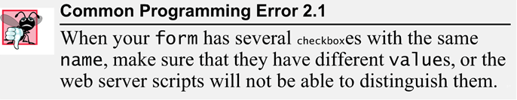
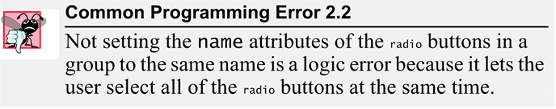
Form

Slide 81
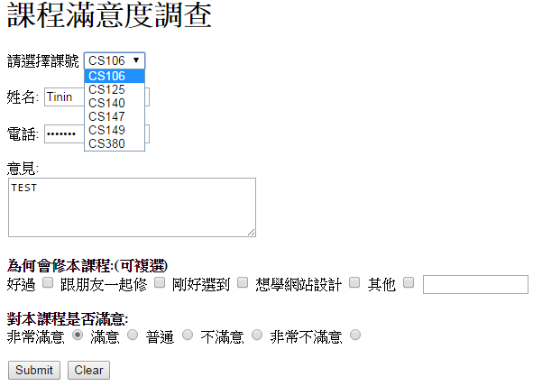
Exercises

Slide 82
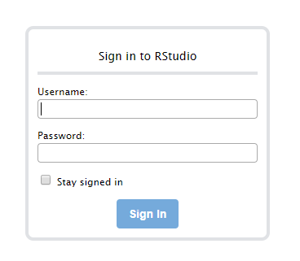
Login server
Rstudio Server
http://140.138.77.70:8787

Slide 83
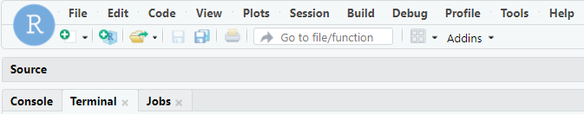
passwd
Changing Password
at least 6 characters
can not too simple
passwd
tinin@class:~$ passwd
Changing password for tinin.
(current) UNIX password:
Enter new UNIX password:
Retype new UNIX password:
passwd: password updated successfully tinin@class:~$

Slide 84
upload file
Step 1 : Open Filezilla
Step 2 : Connect to server
Hostname : 140.138.77.70
Username : s+ STUDENT ID
Password : xxxxxx
Port : 22
Step 3 :upload file (ex.tgz)
Step 4: tar zxvf ex.tgz

Slide 85
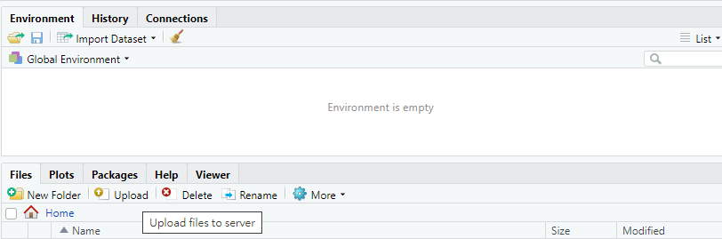
upload file

Slide 86
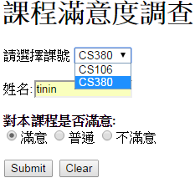

Form + PHP
Form.html
test.php
<!DOCTYPE html>
<html>
<head>
<meta charset = "utf-8">
<title>Forms</title>
</head>
<body>
<h1>課程滿意度調查</h1>
<form method = "post" action = "test.php">
<p>
<label>請選擇課號
<select name = "class">
<option selected>CS106</option>
<option>CS380</option>
</select>
</label>
</p>
<p><label>姓名:<input name = "name" type = "text" size = "12"></label></p>
<p>
<strong>對本課程是否滿意:</strong><br>
<label><input name = "rating" type = "radio" value = "good" checked>
滿意</label>
<label><input name = "rating" type = "radio" value = "normal">普通</label>
<label><input name = "rating" type = "radio" value = "bad">不滿意</label>
</p>
<p>
<input type = "submit" value = "Submit">
<input type = "reset" value = "Clear">
</p>
</form></body></html>
<?php
$class = $_POST['class'];
$name = $_POST['name'];
$rate = $_POST['rating'];
print ("<p>你選的課號為: $class</p>");
print ("<p>你的姓名為 : $name</p>");
print ("<p>滿意度 : $rate</p>");
?>

Slide 87
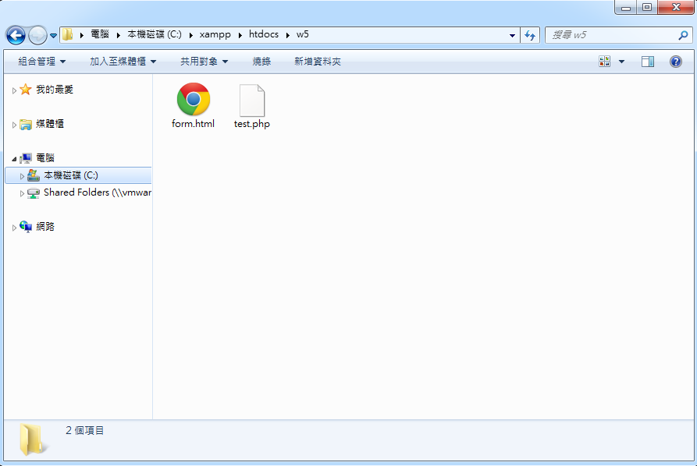
Form + PHP
PHP需放至apache預設目錄下
Windows
C:/xampp/htodcs
Linux
~/public_html

Slide 88
Form + PHP
test.php
<?php
$order = $_POST['order'];
if(isset($order))
{
$n = count($order);
echo("你選擇的餐點為: ");
for($i=0; $i < $n; $i++)
{
echo($order[$i] . "號餐 ");
}
}
?>
Form.html
<!DOCTYPE html>
<html>
<head>
<meta charset = "utf-8">
<title>Forms</title>
</head>
<body>
<h1>訂購單</h1>
<form method = "post" action = "test.php">
<p>
<strong>請選擇餐點:</strong><br>
<label><input name = "order[]" type = "checkbox" value = "1"> 1號餐</label>
<label><input name = "order[]" type = "checkbox" value = "2"> 2號餐</label>
<label><input name = "order[]" type = "checkbox" value = "3"> 3號餐</label>
</p>
<p>
<input type = "submit" value = "Submit">
<input type = "reset" value = "Clear">
</p>
</form></body></html>

Slide 89
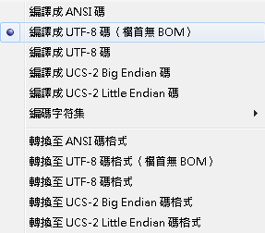
編碼 (windows)
Notepad++
編碼->編譯成UTF-8碼(檔首無BOM)

Slide 90
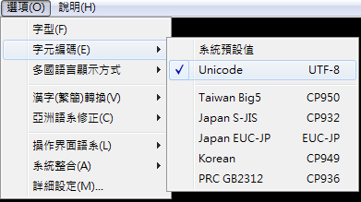
編碼 (linux)
Pietty
選項->字元編碼->Unicode
Big5 to Unicode
iconv -f big5 -t utf-8 big5 infile.html -o outfile.html

Slide 91
Internal Linking
The a tag can be used to link to another section of the same document by specifying the element’s id as the link’s href.
To link internally to an element with its id attribute set, use the syntax #id.

Slide 92
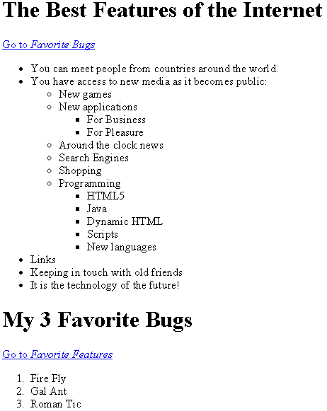
Internal Linking
<!DOCTYPE html>
<html>
<head>
<meta charset = "utf-8">
<title>Internal Links</title>
</head>
<body>
<h1 id = "features">The Best Features of the Internet</h1>
<p><a href = "#bugs">Go to <em>Favorite Bugs</em></a></p>
<ul>
<li>You can meet people from countries
around the world.</li>
<li>You have access to new media as it becomes public:
<ul>
<li>New games</li>
<li>New applications
<ul>
<li>For Business</li>
<li>For Pleasure</li>
</ul>
</li>

Slide 93
Internal Linking
<li>Around the clock news</li>
<li>Search Engines</li>
<li>Shopping</li>
<li>Programming
<ul>
<li>HTML5</li>
<li>Java</li>
<li>Dynamic HTML</li>
<li>Scripts</li>
<li>New languages</li>
</ul>
</li>
</ul>
</li>
<li>Links</li>
<li>Keeping in touch with old friends</li>
<li>It is the technology of the future!</li>
</ul>
<h1 id = "bugs">My 3 Favorite Bugs</h1>
<p>
<a href = "#features">Go to <em>Favorite Features</em></a>
</p>
<ol>
<li>Fire Fly</li>
<li>Gal Ant</li>
<li>Roman Tic</li>
</ol>
</body>
</html>

Slide 94
meta Elements
One way that search engines catalog pages is by reading the meta element’s contents.
The name attribute identifies the type of meta element
The content attribute
Of a keywords meta element: provides search engines with a list of words that describe a page, which are compared with words in search requests
Of a description meta element: provides a three- to four-line description of a site in sentence form, used by search engines to catalog your site. This text is sometimes displayed as part of the search result

Slide 95
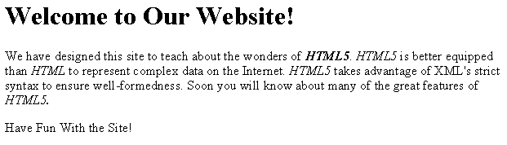
meta Elements
<!DOCTYPE html>
<html>
<head>
<meta charset = "utf-8">
<title>Welcome</title>
<meta name = "keywords" content = "web page, design,
HTML5, tutorial, personal, help, index, form,
contact, feedback, list, links, deitel">
<meta name = "description" content = "This website will
help you learn the basics of HTML5 and web page design
through the use of interactive examples and
instruction.">
</head>
<body>
<h1>Welcome to Our Website!</h1>
<p>We have designed this site to teach about the wonders
of <strong><em>HTML5</em></strong>. <em>HTML5</em> is
better equipped than <em>HTML</em> to represent complex
data on the Internet. <em>HTML5</em> takes advantage of
XML's strict syntax to ensure well-formedness. Soon you
will know about many of the great features of
<em>HTML5.</em></p>
<p>Have Fun With the Site!</p>
</body>
</html>

Slide 96
Q&A

